Slide 1
Coursera – Capstone Project

Slide 2
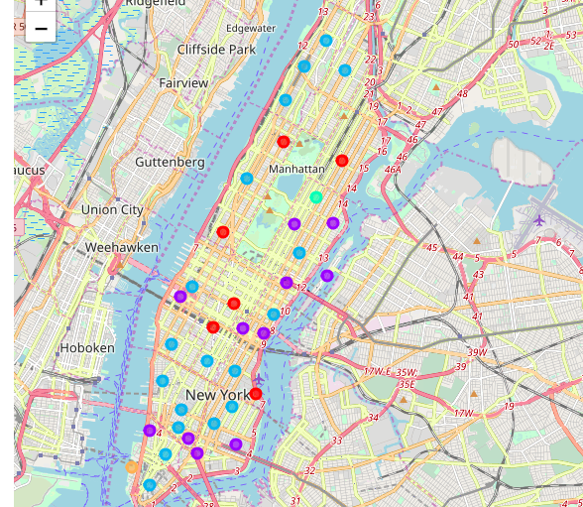
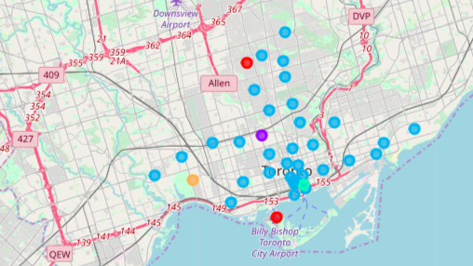
Data Science Application Through Clustering Algorithm
Business Problem:
Does the two financial capitals have similar clustering of neighborhoods.
Can we compare the clusters generated for New York & Toronto for similarity.
Clusters of Neighborhood in NY
Clusters of Neighborhood in Toronto

Slide 3
Methodology & Results
Methodology
Results
Postal code data for Canada & New York is used as input
Foursquare API is used for deriving venues around neighborhoods.
Kmeans clustering technique is used for clustering neighborhoods.
Silhouette measure is used for comparing the similarity between clusters
The Silhouette score for New York cluster not densely populated.
Clusters for Toronto are well separated suggesting that clusters from NY & Toronto are not similar.

Slide 4
Conclusion
Conclusion:
Based on the Silhouette measures for clusters of each data set, we can conclude the following:
The clusters for New York & Toronto are dissimilar, even though both the cities are financial capitals.
New York has sparsely populated clusters indicated by low score.
Toronto has well separated clusters based on relatively higher metric score.

Slide 5
Documentation & Reference
Dataset Links:
https://geo.nyu.edu/catalog/nyu_2451_34572
https://en.wikipedia.org/wiki/List_of_postal_codes_of_Canada:_M
Foursquare API:
https://developer.foursquare.com/
Notebooks with Python Code:
https://github.com/satharIBM/CapstoneProject/blob/master/Clustering%20Newyork%20Neighbourhoods.ipynb
https://github.com/satharIBM/Capstone-Project/blob/master/Neighbourhoods%20in%20Toronto%20-%20Clustering.ipynb

